Slide 1
SQL for Data Querying and Analysis
Week 5 Lecture

Slide 2
Agenda
Discuss Final
Database Concepts
Trouble Shooting Techniques

Slide 3
Final Exam!
4 Questions
Posted Tomorrow
Due by Midnight on October 14
Structure similar to recent labs

Slide 4
Database Concepts

Slide 5
Creating and Populating a Database
All of the code we have covered so far concerns querying data from a database
SQL is also used to create, populate, and edit the contents of a database
CREATE, INSERT, UPDATE, DELETE
These types of statements are generally used by database engineers and database administrators
Data scientists/analysts generally do not have “write” permissions to a database meaning they can’t run these statements

Slide 6
CREATE Statement
The CREATE statement is used to create a new empty table
For each column you must specify the header, data type, and length
In addition to column details, you also specify “constraints” within a CREATE statement
What can be customized in constraints?
Which columns are primary/foreign keys
What values are allowed for a column
Are null values allowed for a column
And more!

Slide 7
Demo Set 5.1

Slide 8
INSERT Statement
The INSERT statement is used to insert new data into a table
INSERT statement inputs:
What table you will be inserting values into
What columns you will be populating
What values you will be inserting
If no value is specified for a column the value will be null
More than one row can be inserted in one INSERT statement
Statement will return an error if input values are not consistent with constraints set in CREATE statement

Slide 9
Demo Set 5.2

Slide 10
UPDATE Statement
The UPDATE statement is used to update a row(s) already inserted into the table
UPDATE statement inputs:
What table you will be updating values in
What columns you will be updating
What new values you will be updating
A WHERE clause that specifies which row(s) to update
No WHERE clause will update every row in the table!

Slide 11
Demo Set 5.3

Slide 12
DELETE Statement
The DELETE statement is used to delete rows from a table
DELETE statement inputs:
What table you will be deleting rows from
A WHERE clause that specifies which row(s) to delete
No WHERE clause will delete every row in the table!

Slide 13
Demo Set 5.4

Slide 14
DESCRIBE Statement
The DESCRIBE statement returns information on each field in a table
DESCRIBE Output
Field: Field name
Type: Data type of field
Null: Whether or not the field can be null
Key: Indicates whether or not the field is a key of some kind
Default: Default value of a field (if available)
Extra: Any extra information the engineer included on the field
Information found using DESCRIBE is set in the CREATE statement

Slide 15
Demo Set 5.5

Slide 16
Information Schema
The information schema includes views containing the metadata (data about data) of the database
Includes a tables view, a columns view, a constraints view, a views view and many more
These are views because this schema can only be referenced and not directly updated
For our purposes, common uses of the information schema would be searching for a column or table within a database

Slide 17
Demo Set 5.6

Slide 18
Views
A view is essentially a saved SELECT statement (a query)
When a view is created no data is stored, but underlying code is saved to that view name
Views function quite similarly to tables
A saved view is referenced in the FROM clause of a query

Slide 19
Why Use Views?
Views can easily store data from many sources in one place
Views can replace/abbreviate a complicated or long query
Views can function as a security mechanism
Give users access to pieces of data found in the view without access to underlying data
Common for a user to have access to a view without having access to every table that contributed to that view

Slide 20
Demo Set 5.7

Slide 21
Trouble Shooting Techniques

Slide 22
Query Execution Order
Sub Queries
FROM / JOINS
WHERE
GROUP BY
Aggregate Functions
HAVING
Window Functions
SELECT
DISTINCT
UNION / INTERSECT / EXCEPT
ORDER BY
LIMIT

Slide 23
Tips for Faster Running Queries
Put more selective conditions first in WHERE clause
While checking for subsequent conditions, server will have fewer rows to parse through
Filter before joining!
Joins can be very computationally taxing so filtering before as opposed to after joining can decrease run time

Slide 24
Tips for Faster Running Queries Cont.
Avoid using SELECT DISTINCT
DISTINCT requires parsing through every single row and checking against every other row to see if there is an equivalent
If you are dealing with duplicates there is most likely something you could change earlier in your code to eliminate them
Try to understand why your code is generating duplicates as opposed to leaning on a DISTINCT
Use UNION ALL instead of UNION whenever possible
Like DISTINCT, UNION checks for duplicates and must parse every row for comparison in each set in your query

Slide 25
Tips for Faster Running Queries Cont.
Avoid calculations in your WHERE clause
If a condition includes a calculated value the value will need to be recalculated and compared for every row in the table
Example: WHERE CONCAT(firstNAME, lastName)) = ‘SeanScott’
Avoid ORDER BY
Like DISTINCT, sorting rows requires parsing through each row and then comparing it to every other row to determine its place in the order

Slide 26
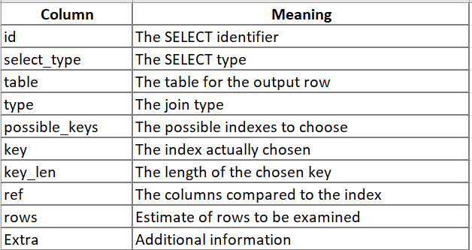
EXPLAIN Statement
The EXPLAIN statement provides information on the execution plan of a query
Can be used with a SELECT, INSERT, DELETE, UPDATE statement
Returns a row for each table used in query in order of execution
Columns of EXPLAIN output:
EXPLAIN ANALYZE is a more powerful version of EXPLAIN that includes run times for each step of query (unavailable in MySQL)

Slide 27
Demo Set 5.8

Slide 28
Review
CREATE, INSERT, UPDATE, and DELETE statements are used to create and populate databases
Learn more about a database by using the DESCRIBE statement and querying the information schema
Views are saved SELECT statements that can be used to simplify a complicated query, bring data sources together, or serve as a security mechanism
Understanding SQL’s execution order and best practices for computationally efficient queries can save you a lot of time!
Use the EXPLAIN statement to understand a query’s execution order

Slide 29
Resources to Practice
WindowFunction.com: https://www.windowfunctions.com/questions/over/1
Code Academy SQL Course: https://www.codecademy.com/learn/learn-sql
SQL Zoo: https://sqlzoo.net/
W3 Schools: https://www.w3schools.com/sql/sql_exercises.asp

Slide 30
Thank You!

